Slide 1
CHEMICALS AND THE EARTH
Electrolysis of brine (salty water)

Slide 2
Lesson objectives
To predict what will happen during the electrolysis of brine
To see what happens during the electrolysis of brine
To explain what happens during the electrolysis of brine
To know some of the uses of the products of the electrolysis of brine

Slide 3
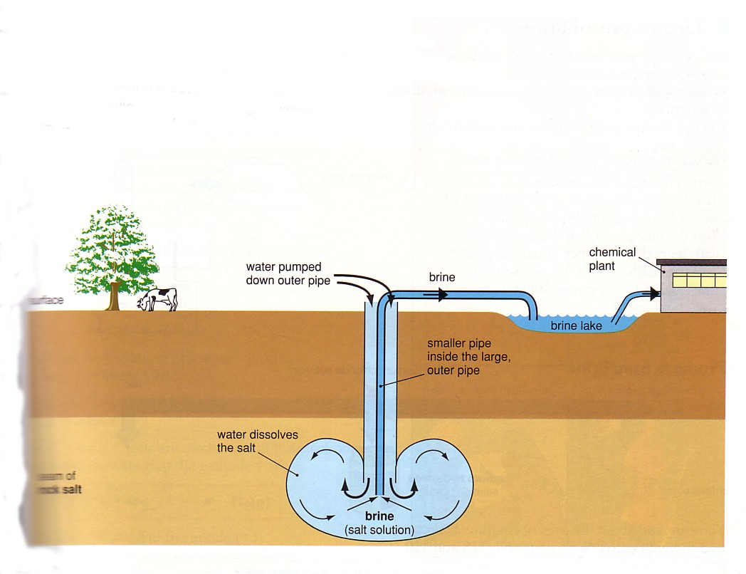

Slide 4
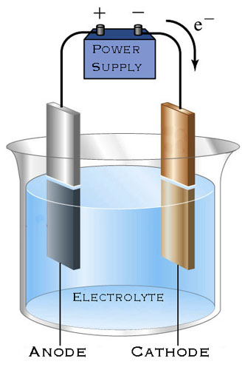
set up you would need for electrolysis

Slide 5
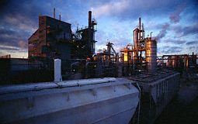
Electrolysis of brine
When NaCl dissolves in water, it’s ions become free to move. So the solution can be electrolysed.
In water some of the molecules of water will naturally split apart.

Slide 6
Electrolysis of brine
The NaCl will split into Na⁺ ions and Cl⁻ ions.
Water splits into H⁺ ions and OH⁻ (hydroxyl) ions.
So what do we think will happen during electrolysis?
Remember – Na is VERY reactive, it is much more likely to exist as an ion than hydrogen.

Slide 7
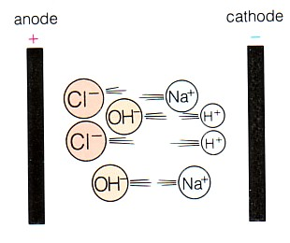

Slide 8
Now let’s see what actually happens

Slide 9
Electrolysis of brine
The H⁺ and Cl⁻ ions are discharged at the electrodes.

Slide 10
Electrolysis of brine
Hydrogen comes off at the cathode ( - )
2H⁺_{(aq)} + 2e⁻ H_{2(g)}
Hydrogen is …… oxidised or reduced?

Slide 11
Electrolysis of brine
Chlorine comes off at the anode ( + )
2Cl_{(aq)} - 2e⁻ Cl_{2(g)}
Chlorine is …… oxidised or reduced?

Slide 12
Electrolysis of brine
The Na⁺ and OH⁻ ions stay in solution.
They join together to form sodium hydroxide.
This is a very important alkali

Slide 13
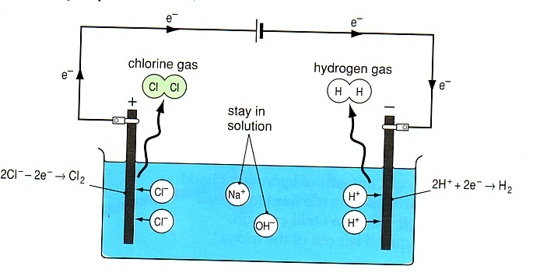

Slide 14
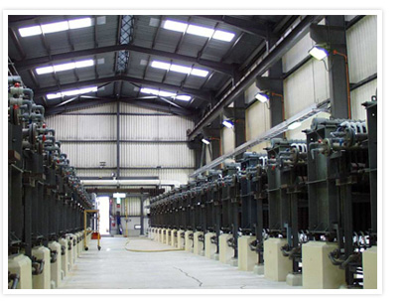
Industrial chlorine production from electrolysis of brine

Slide 15
Uses of the products of the electrolysis of brine

Slide 16

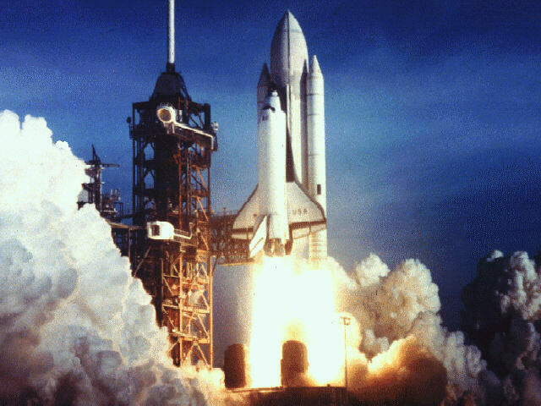
Hydrogen
Used to make margarine (helps to make the oils in the margarine spread on your bread)
Used as a fuel (already important in space rockets, but may be the fuel of cars after the oil age)

Slide 17
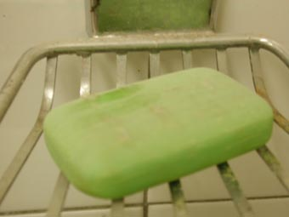

Sodium hydroxide
Detergents and soap
Paper

Slide 18
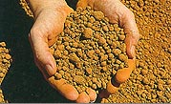

Sodium hydroxide
Purifying bauxite to extract aluminium
Rayon and acetate fibres

Slide 19


Chlorine
Bleach
Killing bacteria in water

Slide 20
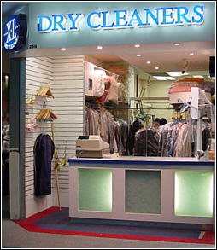
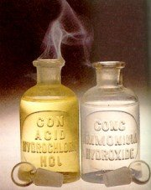
Chlorine
Solvents (used in dry cleaning)
Hydrochloric acid (HCl)

